Slide 1


Thermal Analysis of a 2U CubeSat
Team 18
Parker Southwick, Jeremy Lowman, Katherine Popchock ,Thomas Otero, Tyler Benson and Griffin Johnson

Slide 2
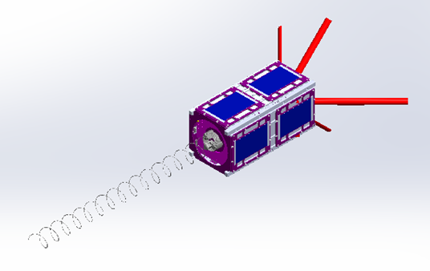
Outline
CubeSat Background
Mission Statement
Timeline
Design Progress
Conclusion

Slide 3
CubeSat Background
Mission Statement
2U CubeSat
Project under the CubeSat Launch Initiative (CSLI), NASA Oregon Space Grant Consortium (OSGC) and the Portland State Aerospace Society (PSAS)
Develop an accurate ANSYS thermal simulation to determine the thermal states the satellite undergos, and provide actionable design recommendations.

Slide 4
Timeline
10/01 - 12/31 | Research other CubeSat projects. Simulation setup, assumptions made, thermal contacts, materials used, frame design, etc. Write up a Product Design Specification (PDS). Have a simplified SolidWorks model ready.
1/1 - 2/28 | Initial thermal simulations of the satellite. Create actionable data for the OreSat prototype frame to be tested in the vacuum chamber.
3/1 - 3/31 | Determine temperature fields, including the best case and worst case scenarios.
4/1-4/30 | Suggest an optimal roll rate for the CubeSat. First thermal tests in the vacuum chamber. Critical Design Review (CDR) after the first tests.
5/1 - 5/31 | Suggest any material changes after physical testing in the vacuum chamber.
6/1 - 6/29 | Final documentation.

Slide 5
Design Progress
Winter
Completed ANSYS edX training course through Cornell university
Developed and refined hand calculations for a 2D model
Built 2D simulation
Built 3D simulation - basic model

Slide 6
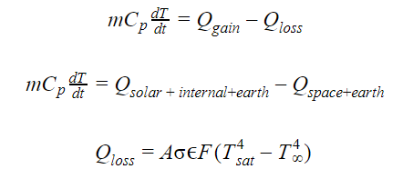
Hand Calculations
These will give us a good idea of what kind of solutions to expect when running analysis in ANSYS.
Lumped capacitance assumes uniform Temperature throughout

Slide 7

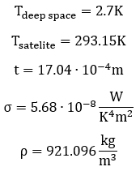
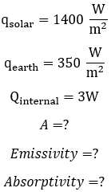
Hand Calculations

Slide 8
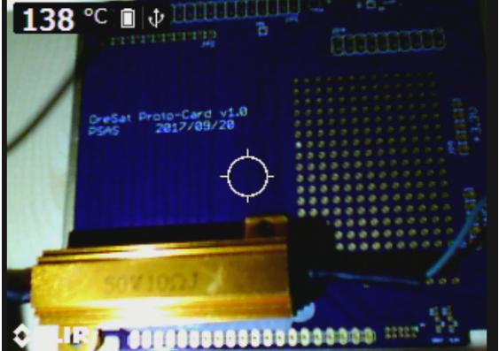
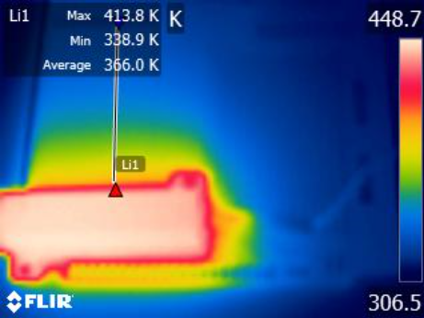
Circuit Board Testing

Slide 9
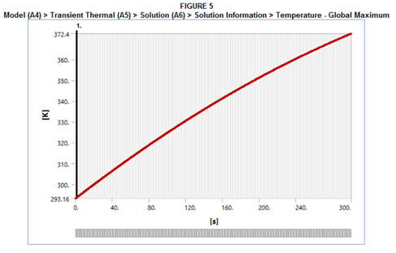
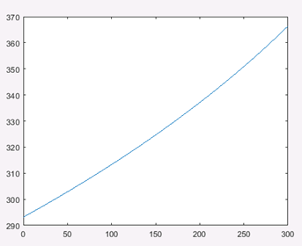
ANSYS Thermal Analysis
2D Plate vs Matlab Results
Ansys: Matlab:
Max 372.4 K (99° C) Max 366.4 K (93° C)

Slide 10
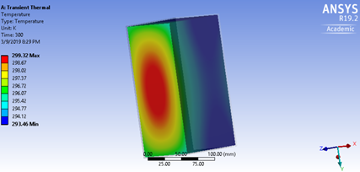
ANSYS Thermal Analysis
Basic Hollow Cube
Basic representation of a 3D hollow cube
Analysis runs for a period of 5 minutes (300 s)
Initial temperature of 20° C

Slide 11

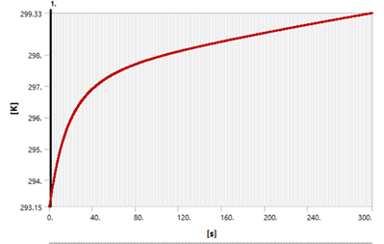
ANSYS Thermal Analysis
Basic Hollow Cube
Basic representation of a 3D hollow cube
Simulates worst hot case
Final temperature of 26° C

Slide 12
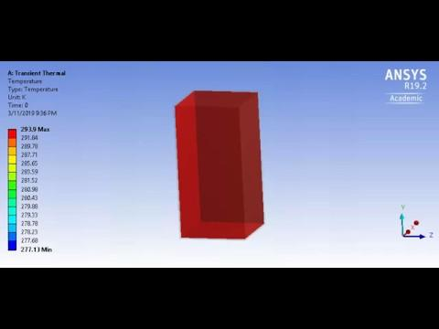
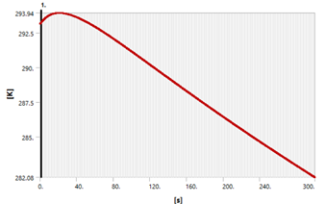
ANSYS Thermal Analysis
Basic Hollow Cube
Basic representation of a 3D hollow cube
Simulates worst cold case
Minimum temperature of 4° C

Slide 13
Next Steps / Conclusion
Add in values for emissivity and absorptivity
Calculate projected area and determine best and worst tilt angle
Run longer simulations until the temperature approaches a limit
More complex model using full version of ANSYS - finer mesh
Make adjustments to model to capture more scenarios

Slide 14
Questions?

